Slide 1
Simple Animation

Slide 2
Agenda
Simple Animation
Sample output
Simple Animation implementation

Slide 3
Simple Animation
In CSS we can perform animations.
Animation is nothing but changing one style of a html tag to another style.
We use @keyframe to specify the new style to which the current style has to be transformed.
To bind the new style to html tags we use animation name (animation-name: name here).
We will define the animation properties like duration, delay start, no of repetitions,..etc in the html tag styling selector.

Slide 4
Simple Animation
Example of div tag styling:
.abc{
width: 100px;
height: 100px;
animation-name: colorchange; // binding the keyframe with class
animation-duration: 4s; // animation will run for 4 seconds
animation-delay: 1s; // animation will start 1 second late
animation-iteration-count: infinite; // animation will repeat infinite times
}
@keyframes colorchange {
from{background-color: green;}
to{background-color: hotpink;}
}

Slide 5
Simple Animation
Example for moving a box
.rotate{
width: 100px;
height: 100px;
background-color: yellow;
position: relative;
animation-name: rotation;
animation-duration: 4s;
animation-delay: 2s;
animation-iteration-count: infinite;
}
@keyframes rotation {
0% {background-color: red; left: 0px; top: 0px;}
25% {background-color: rosybrown; left: 400px; top: 0px;}
50% {background-color: seagreen; left: 400px; top: 300px;}
75% {background-color: tomato; left: 0px; top: 300px;}
100% {background-color: springgreen; left: 0px; top: 0px;}
}

Slide 6
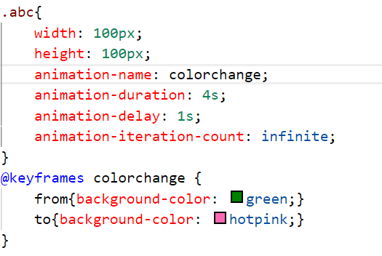


Sample output

Slide 7
Simple Animation implementation
Let’s see implementation of the same

Slide 8
Summary
We can perform some simple animations with the help of CSS properties.
DO NOT WRITE ANYTHING
HERE. LEAVE THIS SPACE FOR
WEBCAM

Slide 9
Thank You
Proprietary content. ©Great Learning. All Rights Reserved. Unauthorized use or distribution prohibited

